Slide 1
Spring Boot Concepts

Slide 2
Objectives
What is Spring Boot?
Spring Version History
Key features of Spring Boot
Developing Your First Spring Boot Application

Slide 3
Spring Boot

Slide 4

What is Spring Boot ?
Spring Boot is a powerful framework built on top of the Spring Framework that simplifies the development of Spring applications. It aims to reduce boilerplate code, configuration, and setup time, allowing developers to focus on building the core functionality of their applications.

Slide 5
Spring Version History
Spring Boot Version | Release Date | Spring framework version
1.0.0.RELEASE | Apr 2014 | 4.0.3
1.5.x | Jan 2017 - Aug 2019 | 4.3.6 - 4.3.25
2.0.0.RELEASE | Mar 2018 | 5.0.4
2.7.x | May 2022 - Aug 2023 | 5.3.20 - 5.3.29
3.0.0 | Nov 2022 | 6.0.2
3.0.x |  | 6.0.2 - 6.0.11
3.1.x | May 2023 - Now
3.2.0 | Nov 23, 2023 | 6.1
3.3.5 | Oct 24, 2024 | 6.1.14
3.4.0 | Nov 21, 2024

Slide 6
Spring Features
Autoconfiguration: Spring Boot automatically configures your application based on the dependencies you include in your project.
Data Access: Seamless integration with various data sources like relational databases, NoSQL databases, and JPA.
Stand-alone Applications: Spring Boot allows you to create standalone applications that can be run directly without the need for external servers.
Embedded Servers: Spring Boot includes embedded servers like Tomcat or Netty, so you can run your application without deploying it to a separate server.
Starter POMs: Spring Boot provides starter POMs that simplify dependency management. You can easily include the necessary dependencies for specific functionalities, such as web development, database access, or security.

Slide 7
Benefits of Using Spring Boot
Rapid Application Development: Quickly create and deploy applications.
Simplified Configuration: Reduce boilerplate configuration.
Embedded Servers: No need for external servers.
Production-Ready Features: Built-in features for monitoring, metrics, and security.
Strong Community and Ecosystem: Large community and extensive documentation.
Simplified deployment: Package your applications as standalone JAR files or WAR files for easy deployment.
Cloud-native support: Seamless integration with cloud platforms like AWS, Azure, and GCP.

Slide 8
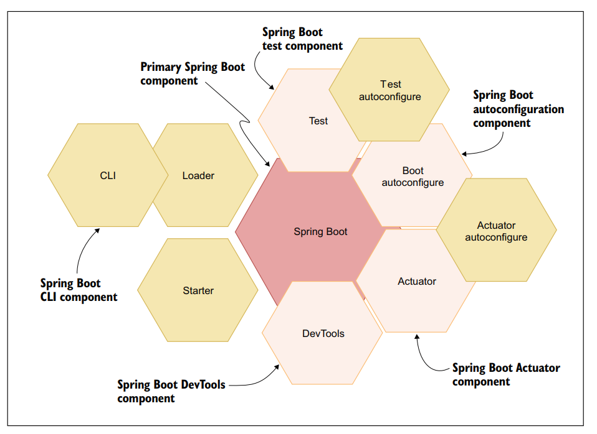
Spring Boot Components

Slide 9
Spring Boot Components
Spring Boot: This is the core of the framework. It provides the SpringApplication class (for creating standalone applications), support for embedded web servers (like Tomcat), and externalized configurations (like database connection details). Think of it as the foundation upon which the other components build.
Spring Boot CLI Component: This is a developer-friendly command-line tool (CLI) that compiles and runs Groovy code. It can also watch for file changes and restart the application automatically, which makes prototyping Spring applications quicker and easier.
Spring Boot Test Component: This enables the use of annotations and methods to write test cases for the Spring Boot application.

Slide 10
Spring Boot Components
Spring Boot DevTools Component: This provides an additional toolkit aimed at improving the development experience. Features include automatic restart upon code changes and LiveReload to refresh the browser when HTML changes.
Spring Boot Autoconfiguration Component: Autoconfiguration automatically configures the bare minimum components needed for a Spring application based on classpath JAR files and properties. It makes educated guesses to configure Spring beans based on the presence of dependencies.
Spring Boot Actuator Component: This provides actuator endpoints to interact with, monitor, and audit a Spring Boot application. These endpoints offer health checks, thread dumps, and other useful metrics to manage the application in production.

Slide 11
Spring Boot Programming Demo

Slide 12
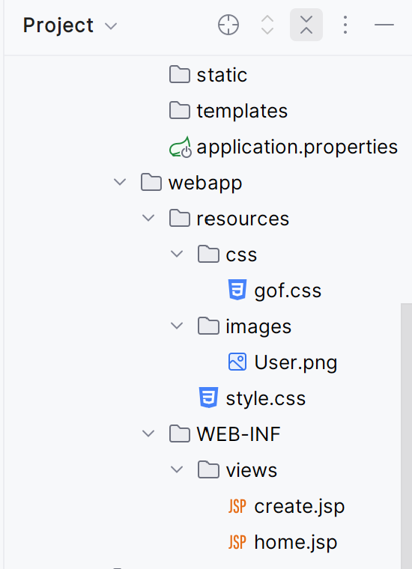
Key Points
Step 01 : Create webapp in the src/main/webapp directory and its importance for JSP files.

Slide 13
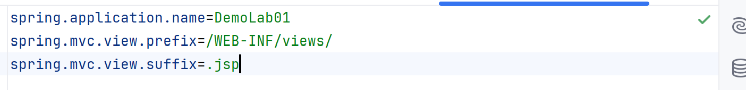
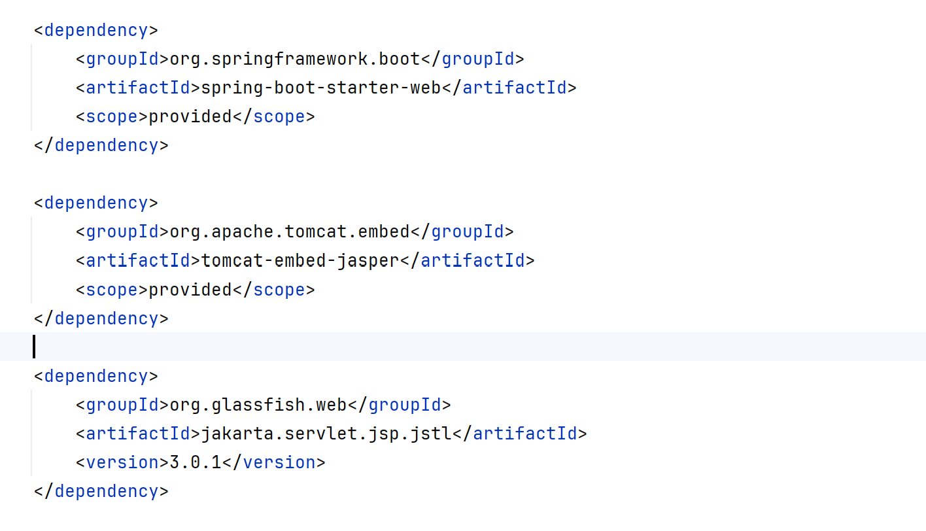
Key Points
Step 02: Config application.properties for JSP
Step 03 : Config the pom.xml

Slide 14
Key Points
Step 03 : Config the pom.xml

Slide 15
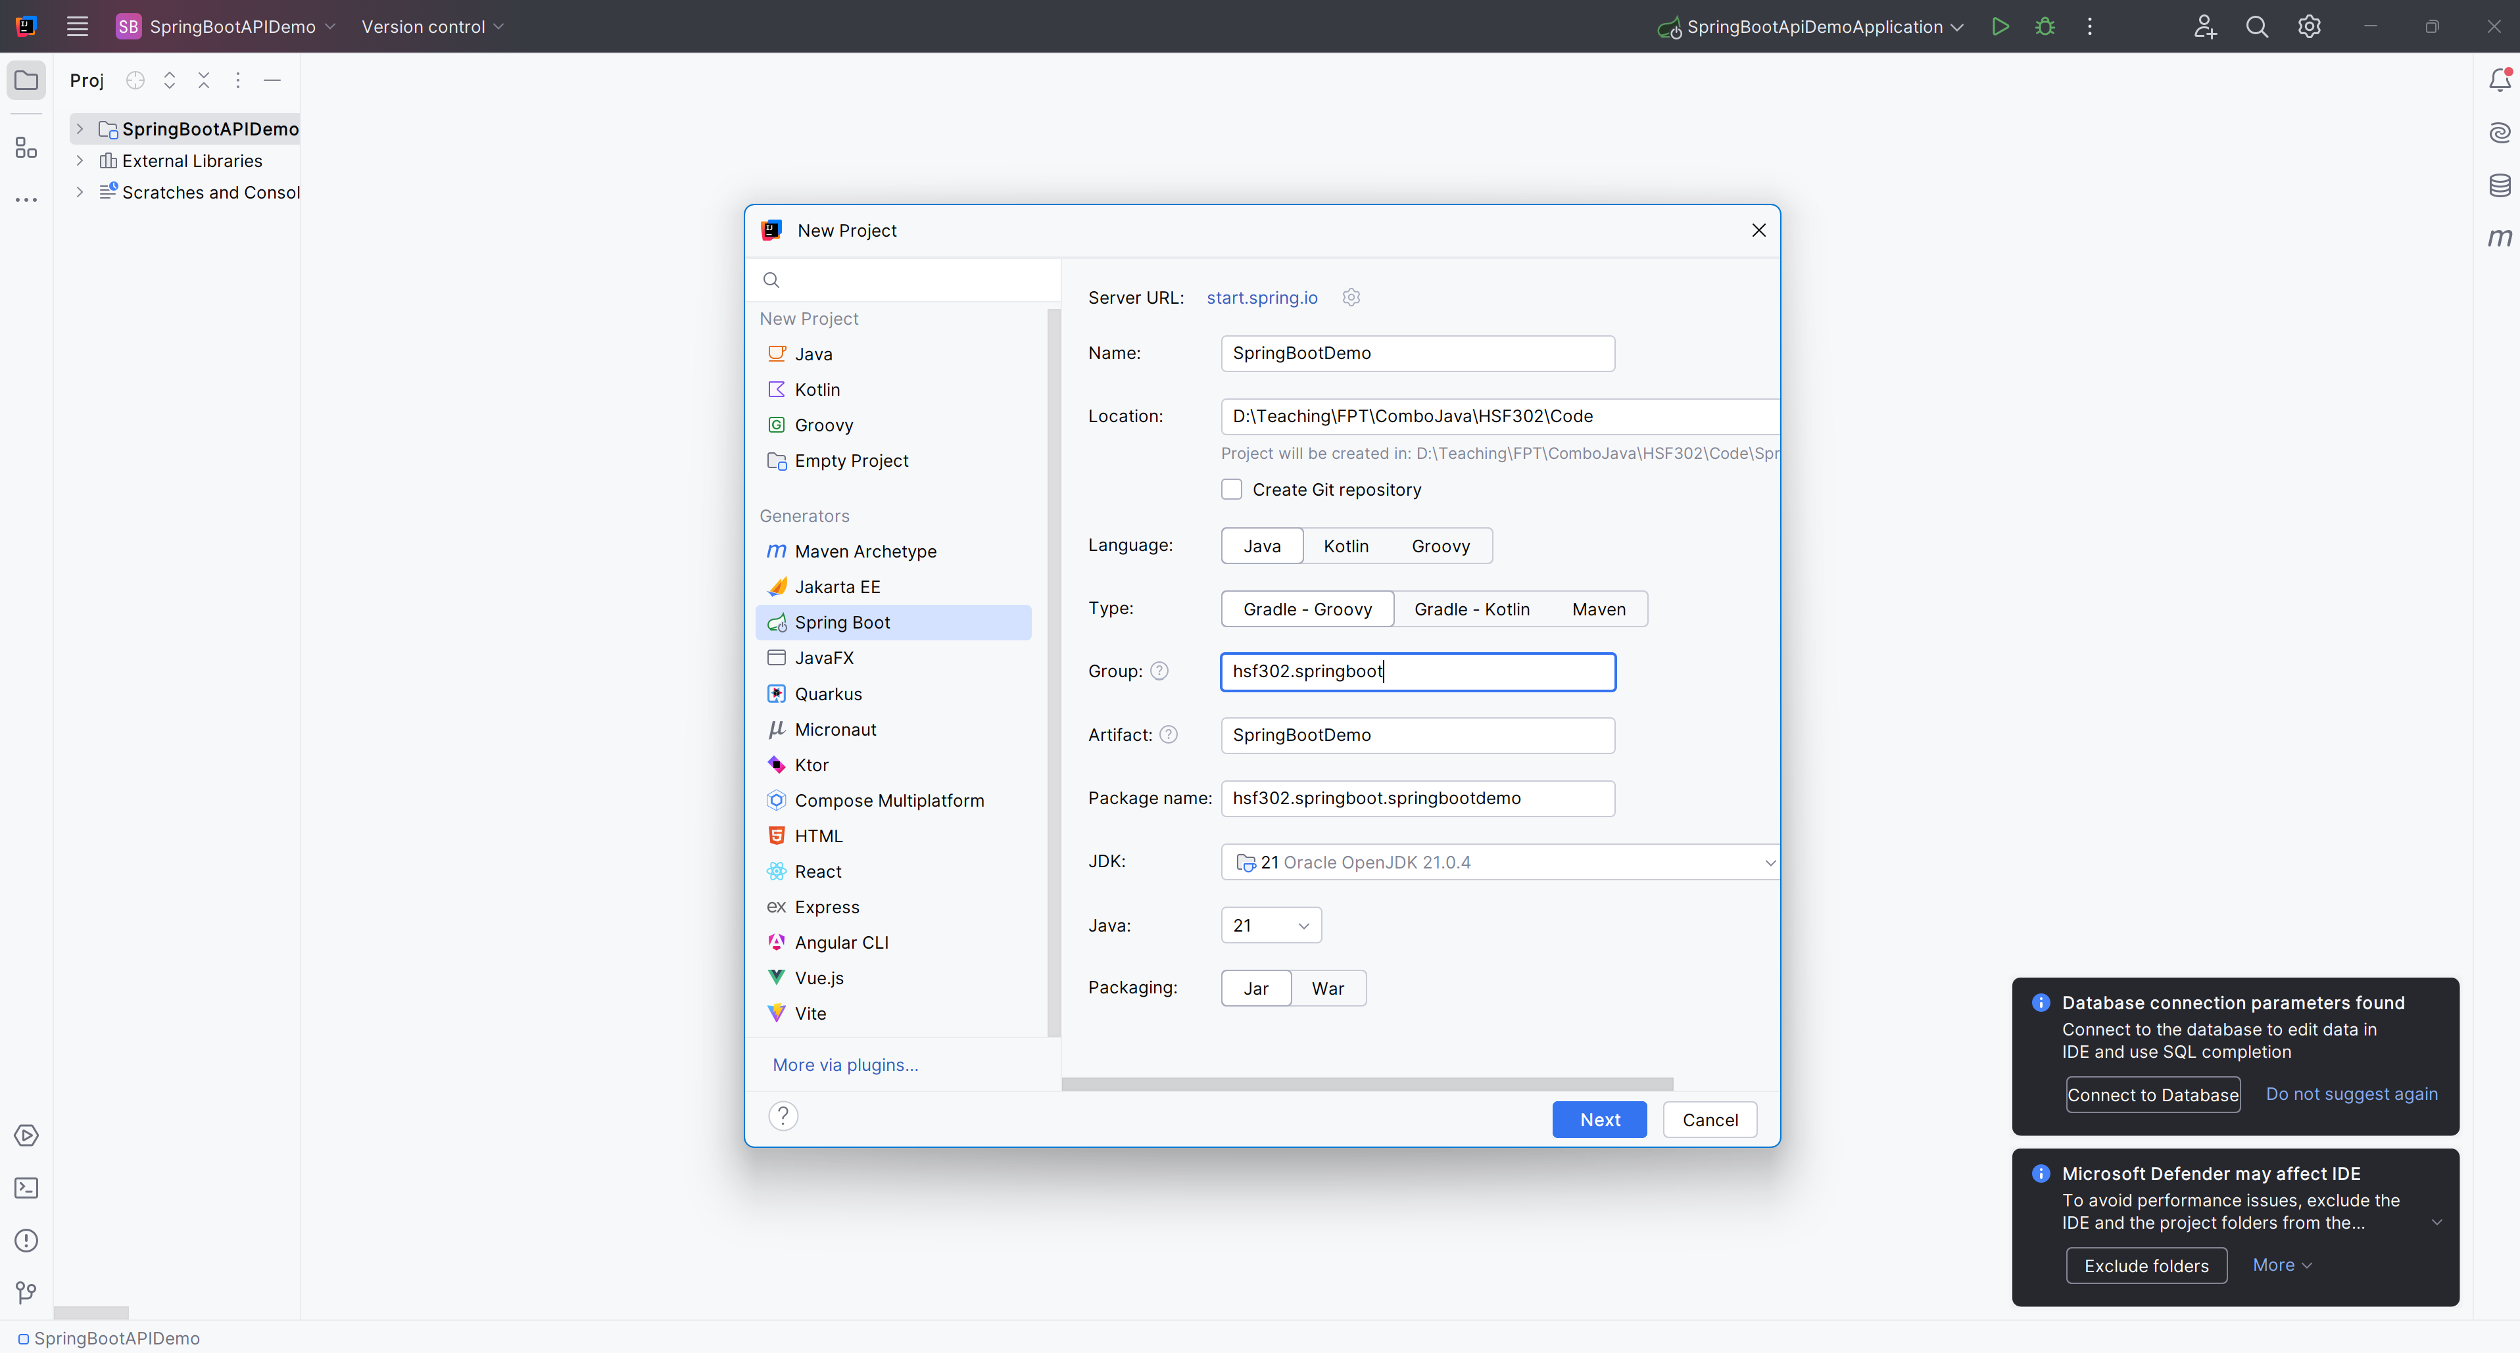
Open IntelliJ, File | New | Maven Project

Slide 16
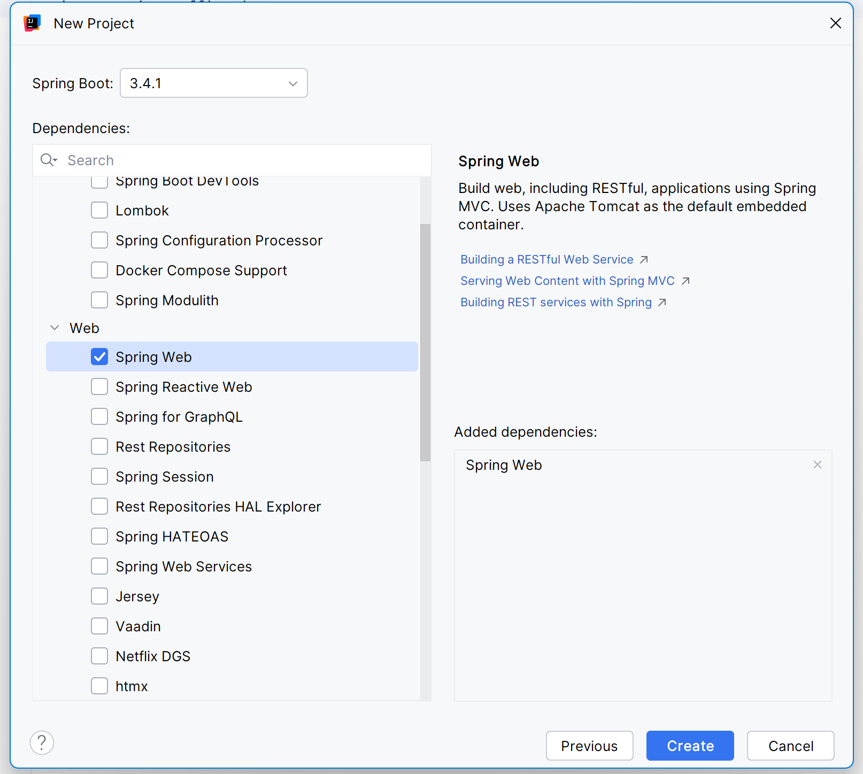
Add Dependences

Slide 17
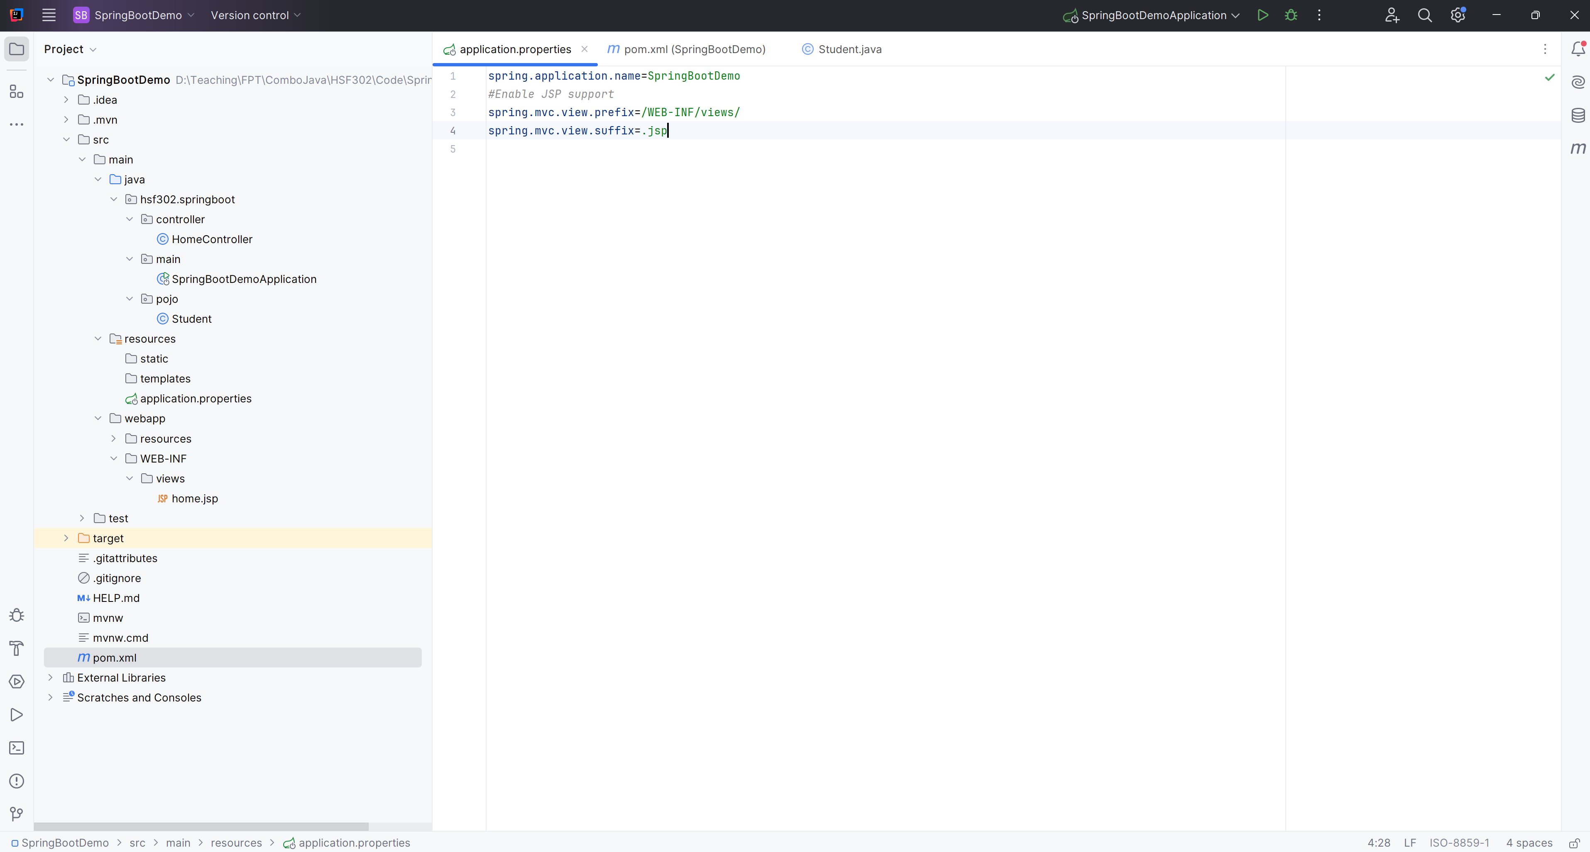
Create the Structure Project

Slide 18
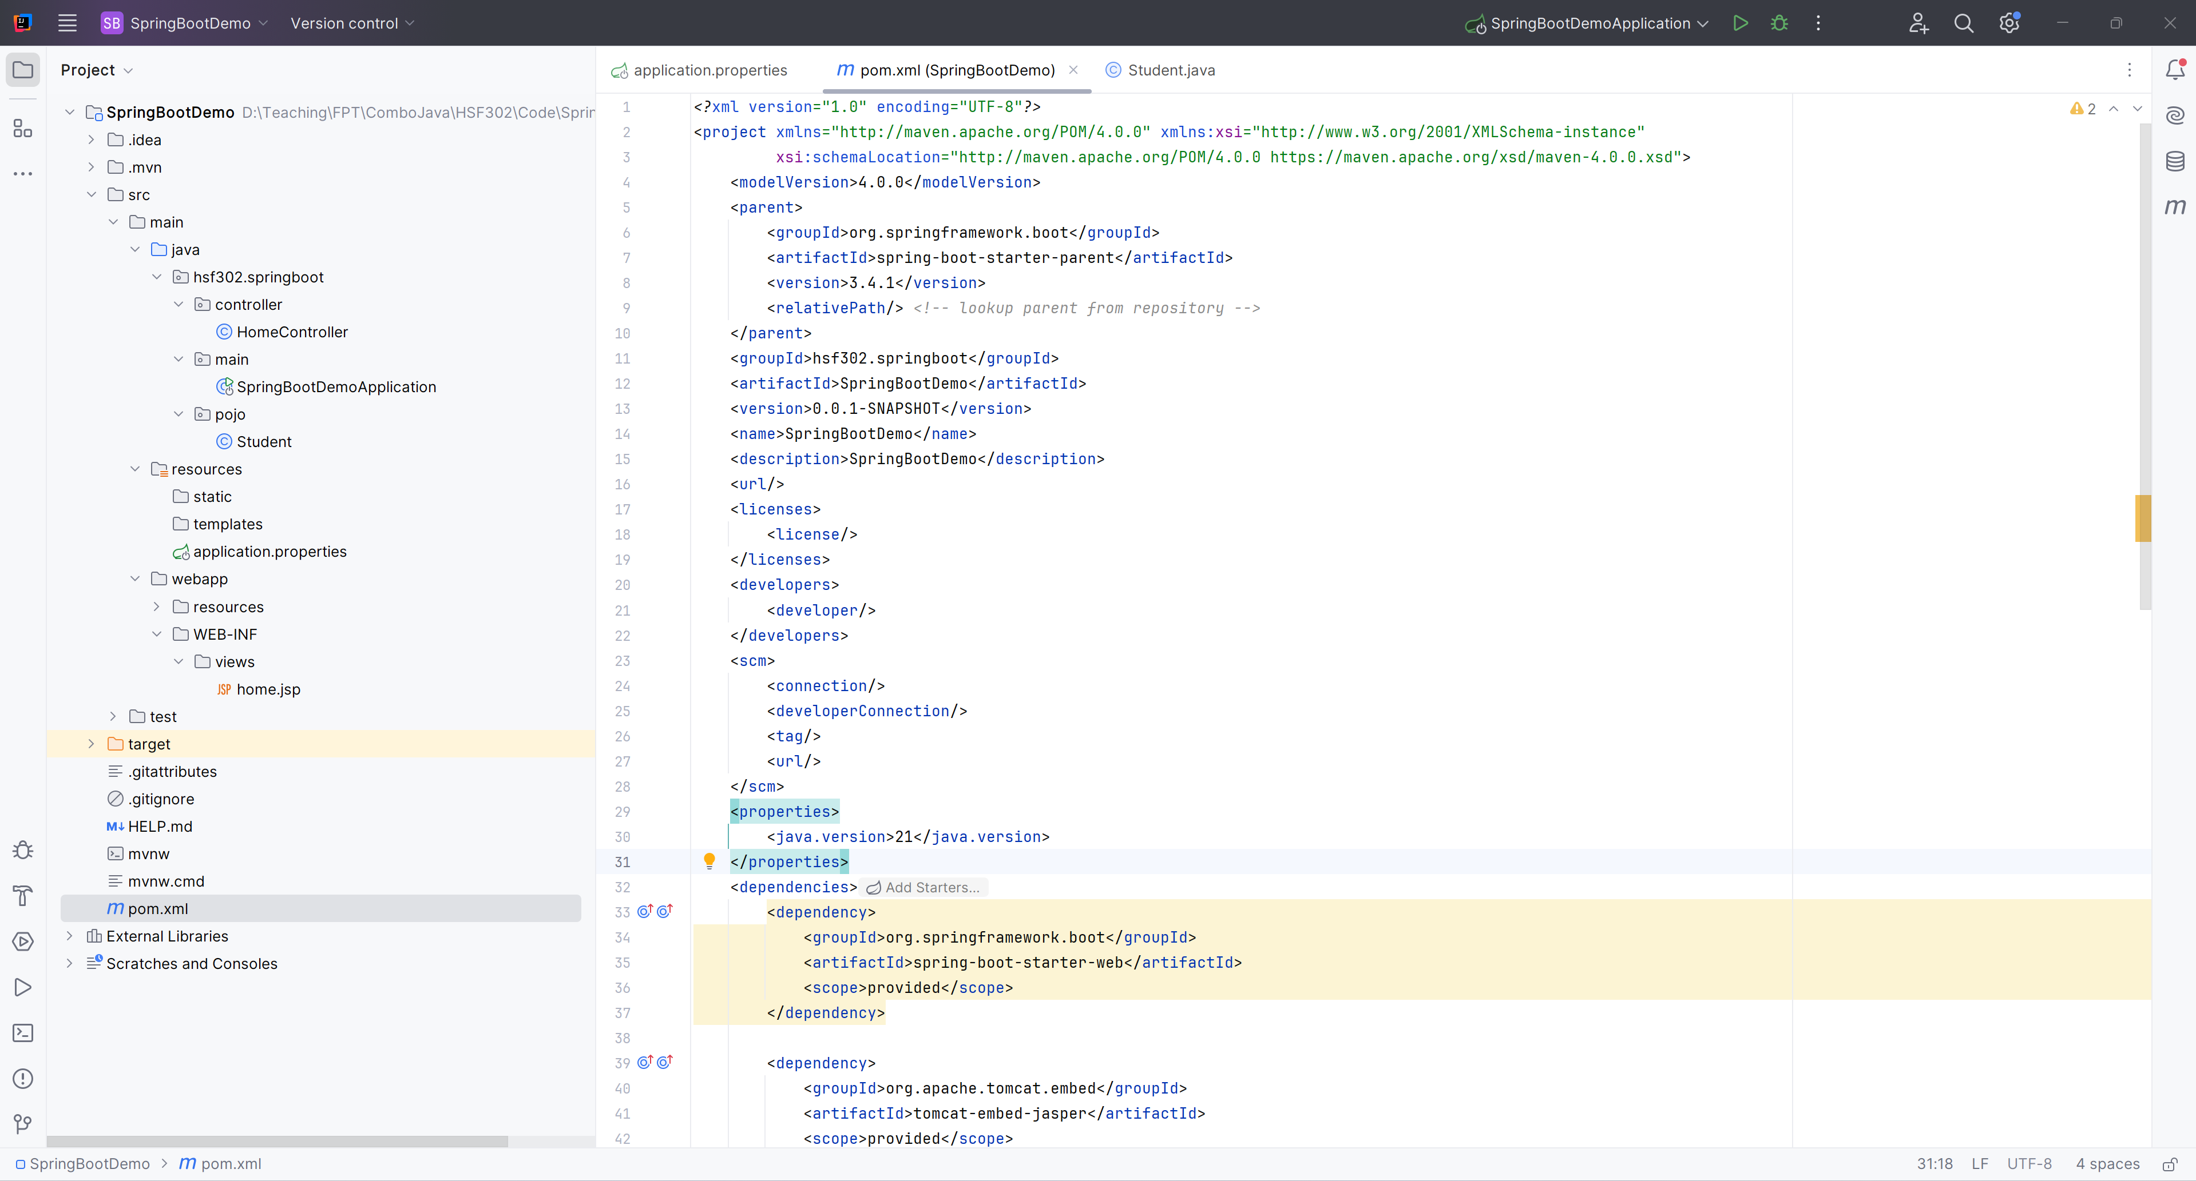
Edit pom.xml

Slide 19
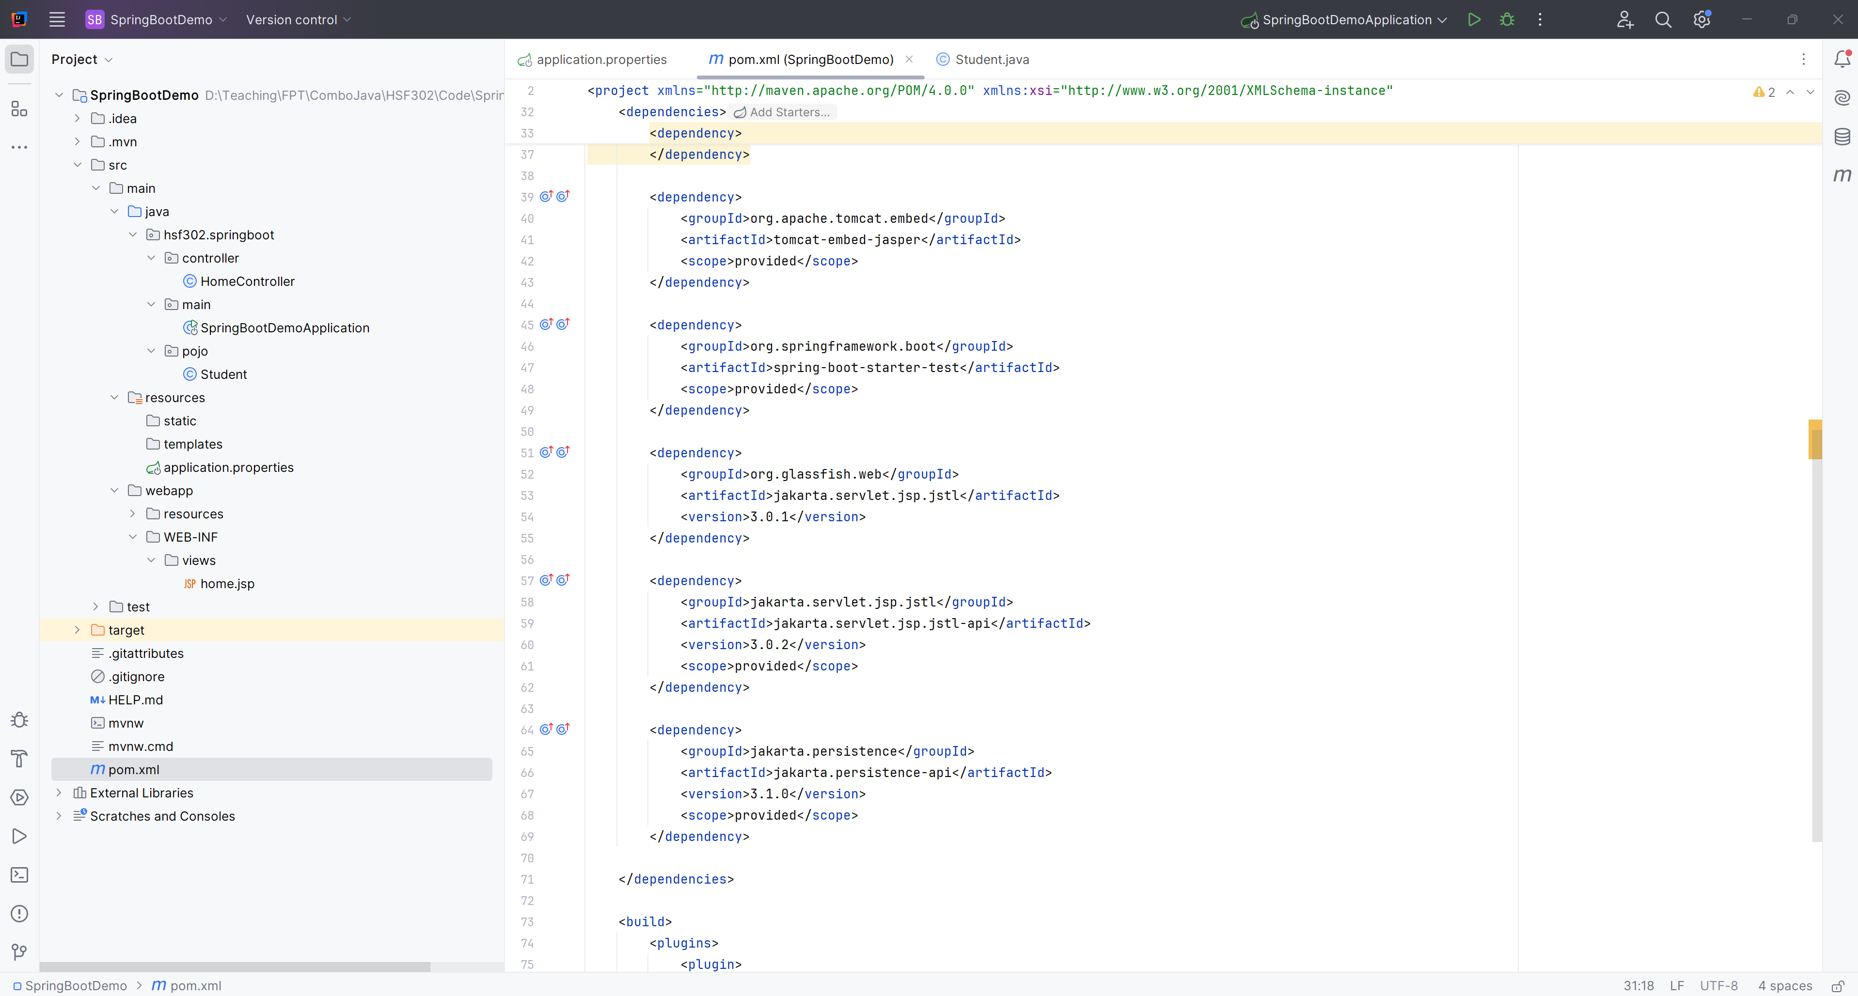
Edit pom.xml

Slide 20
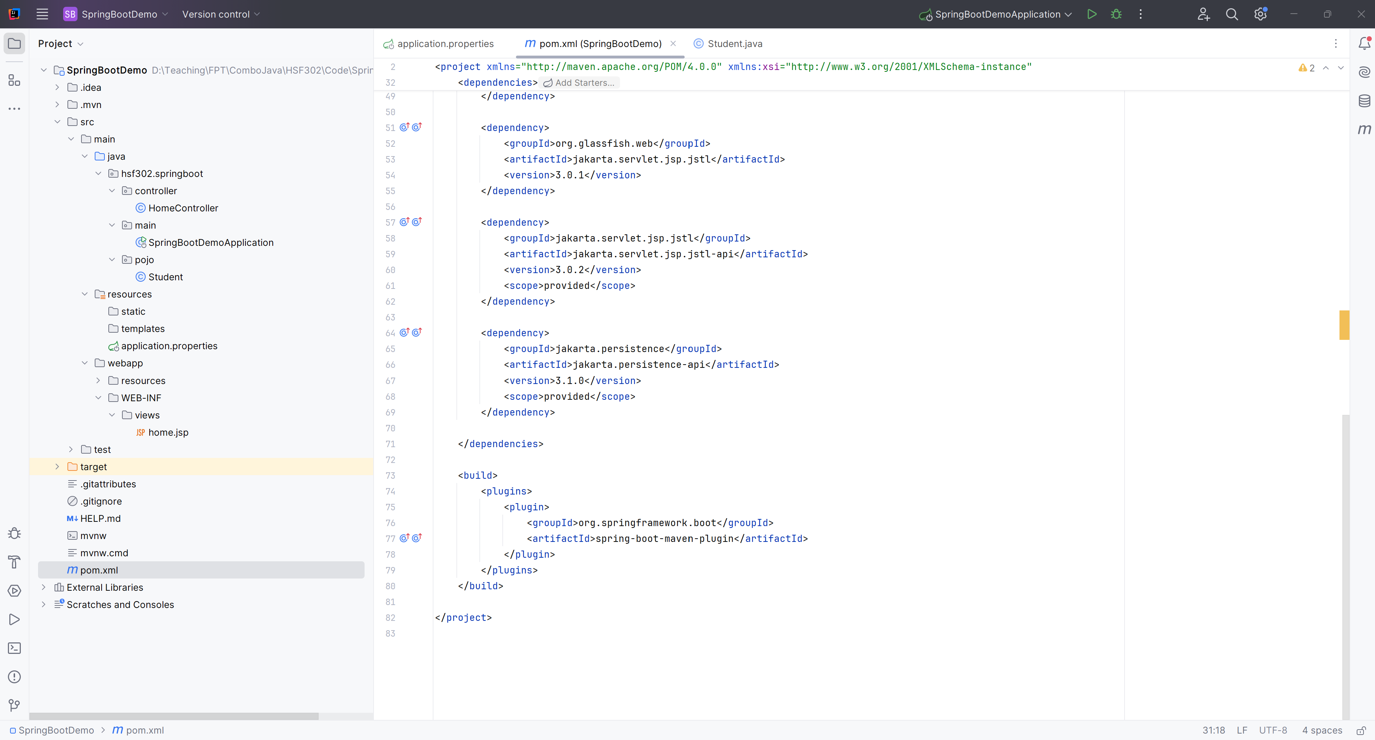
Edit pom.xml

Slide 21
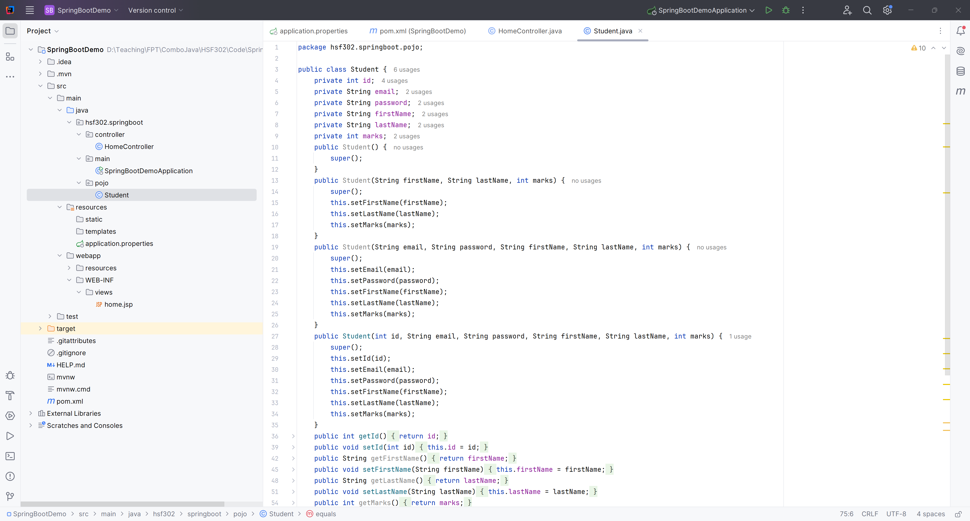
Create the Student.java in pojo

Slide 22
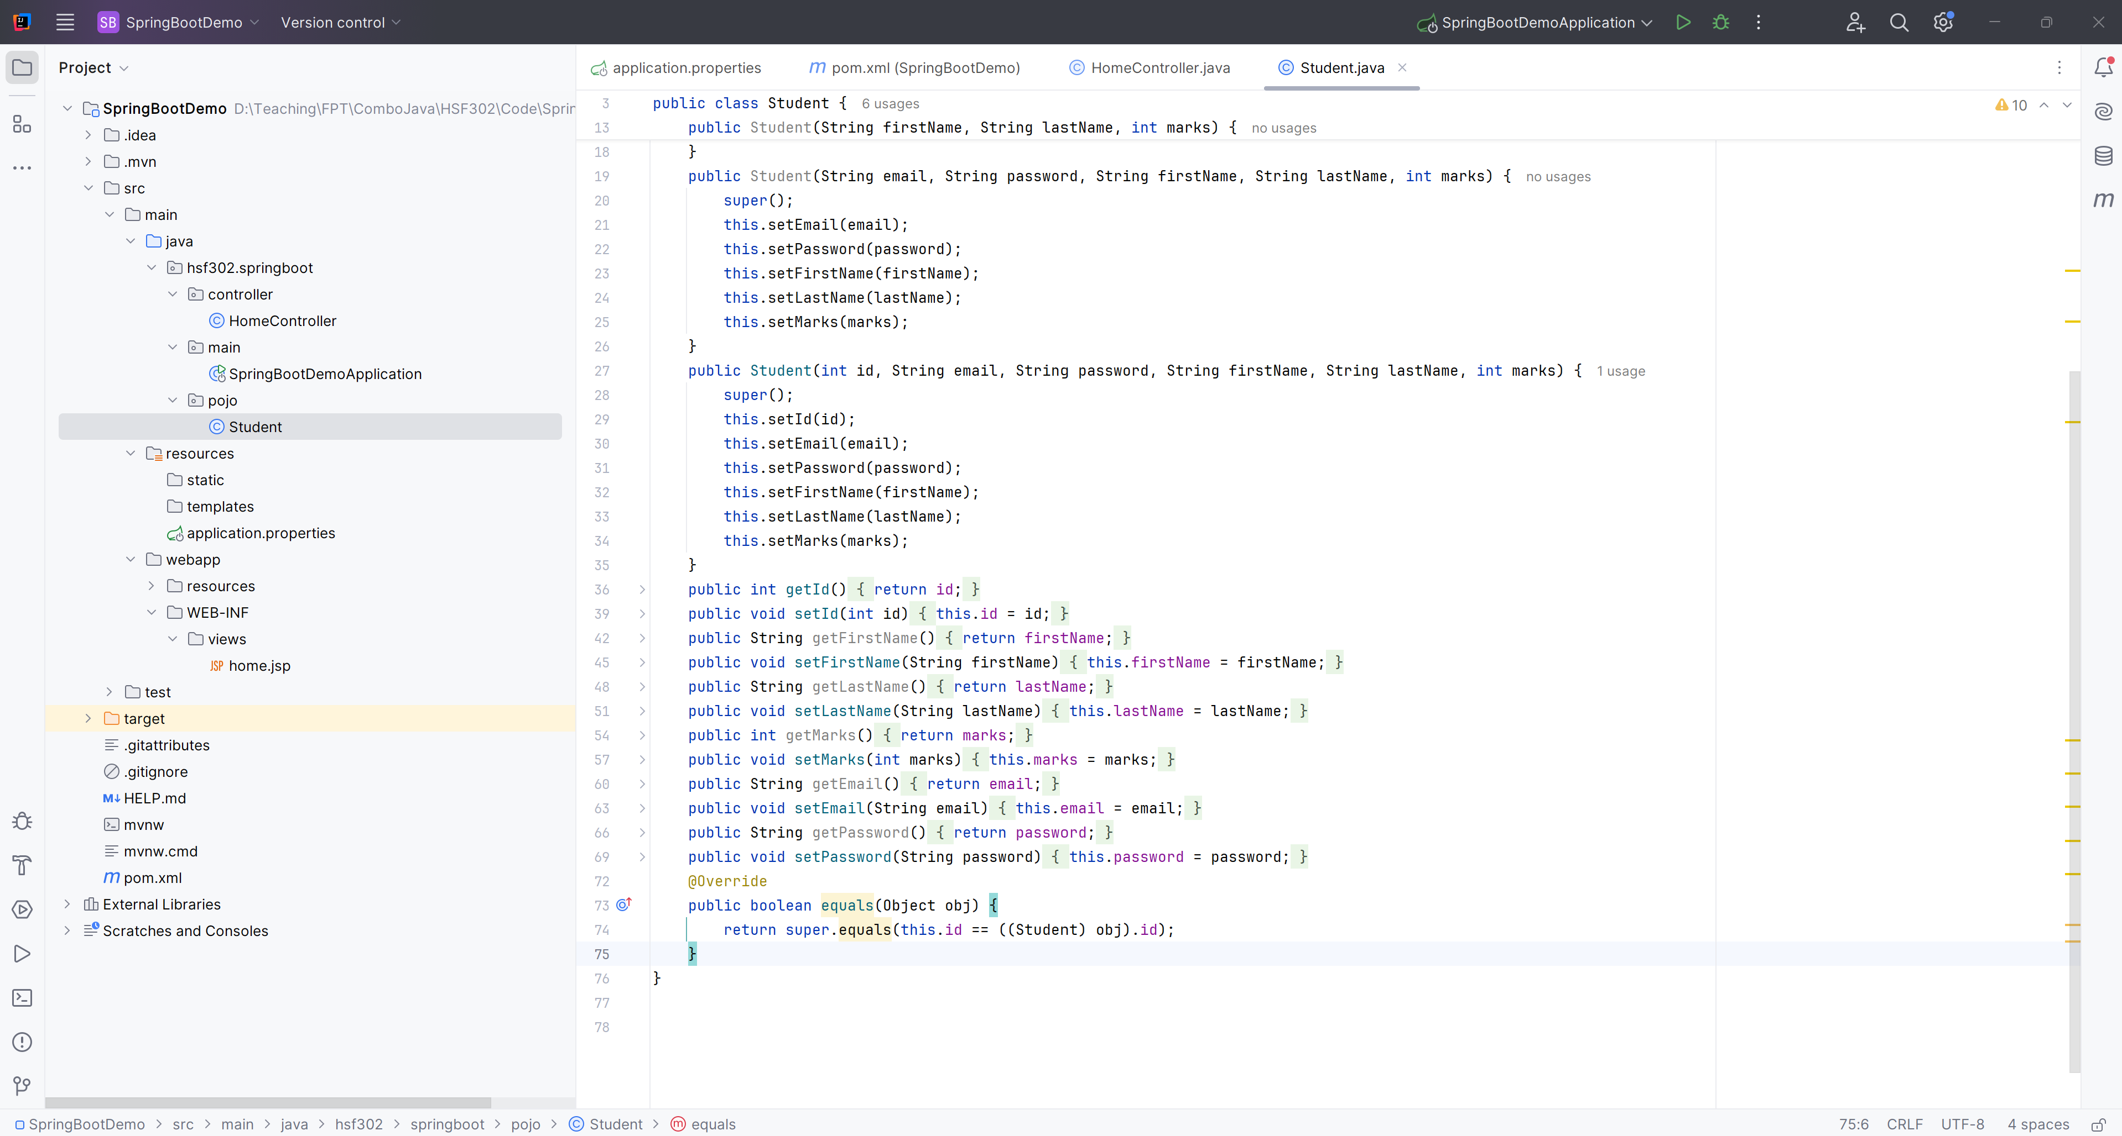
Create the Student.java in pojo

Slide 23
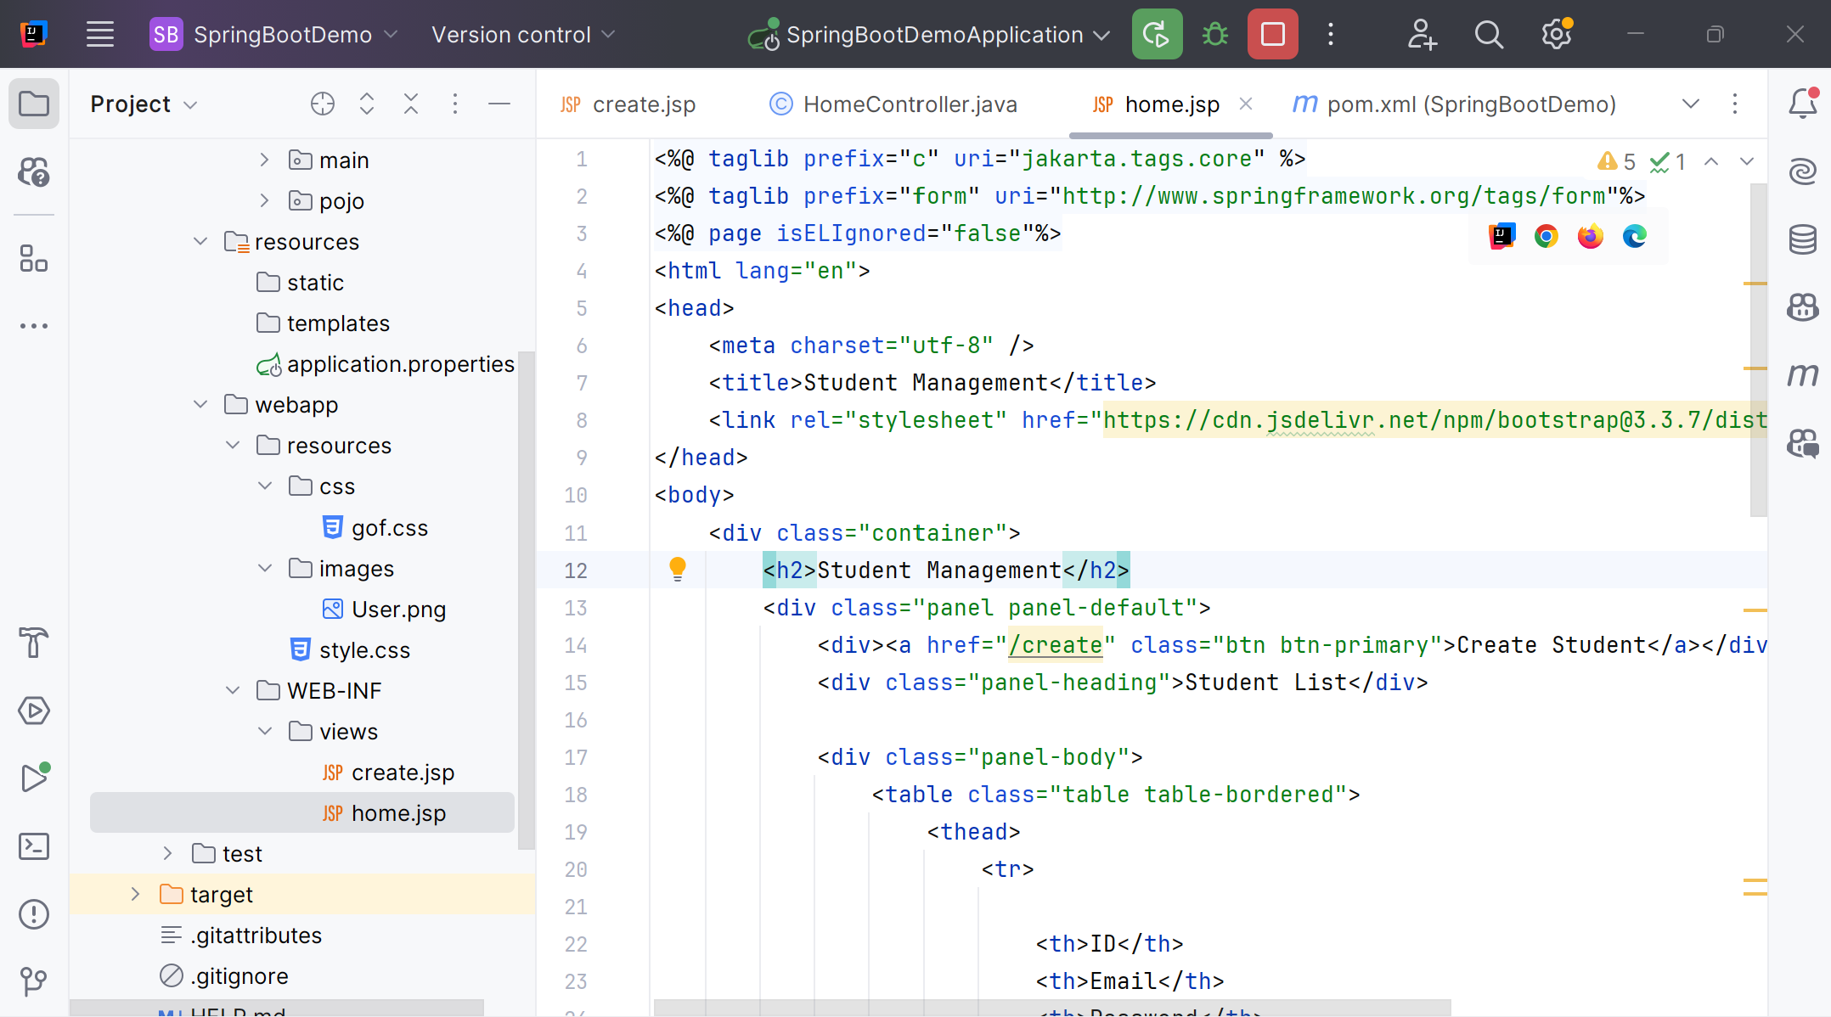
Create views : home.jsp

Slide 24
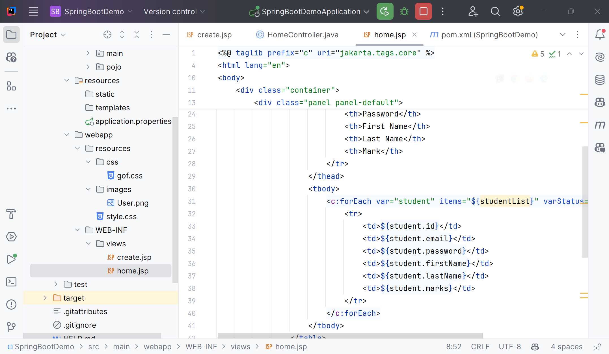
Create views : home.jsp

Slide 25
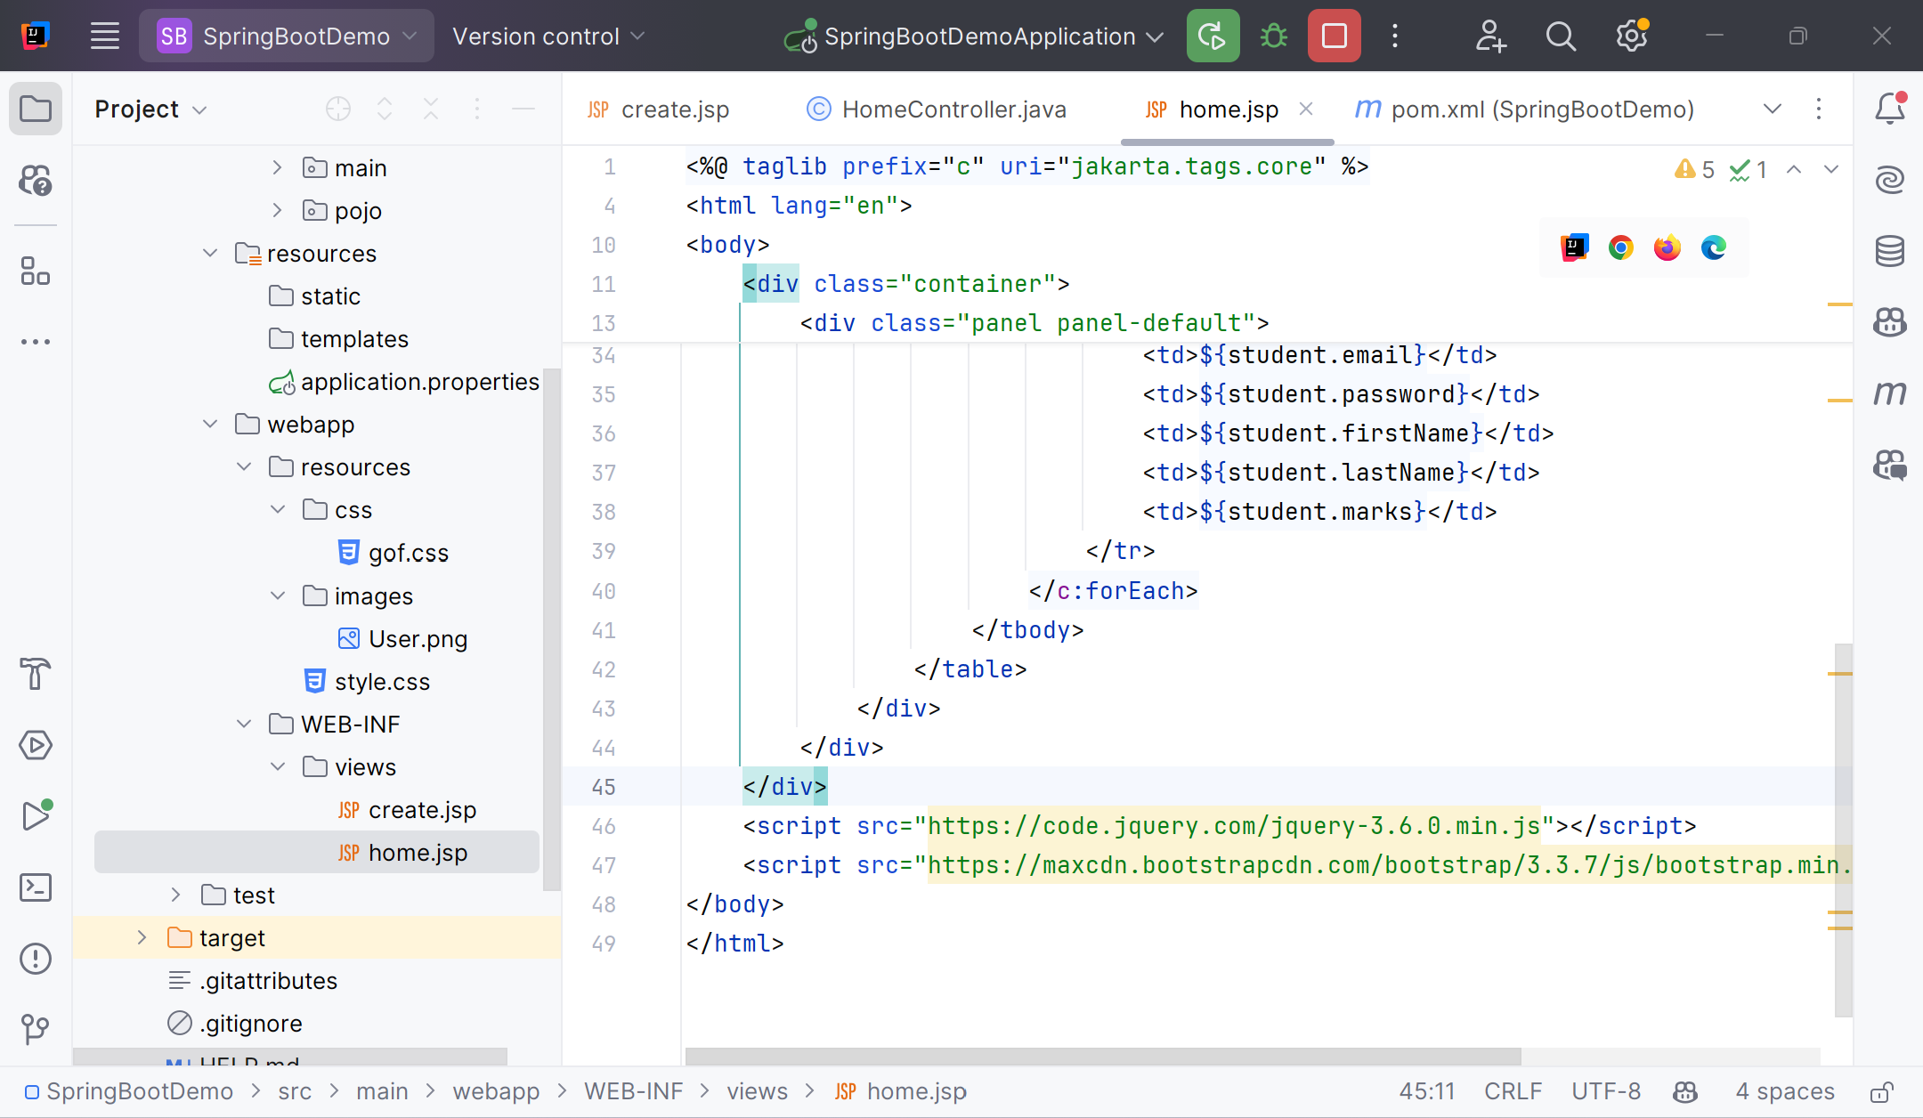
Create views : home.jsp

Slide 26
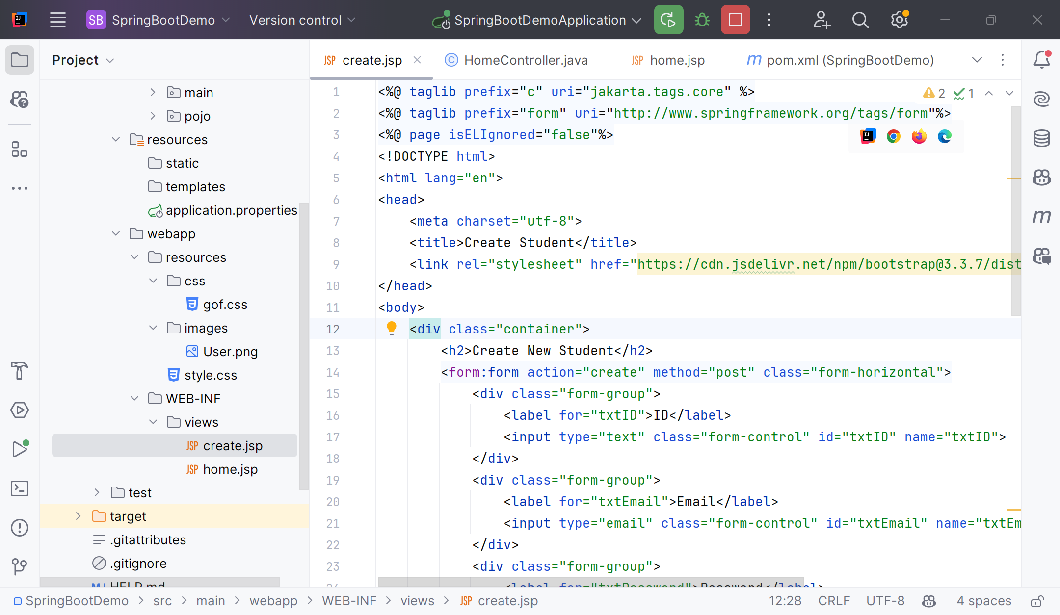
Create views : create.jsp

Slide 27
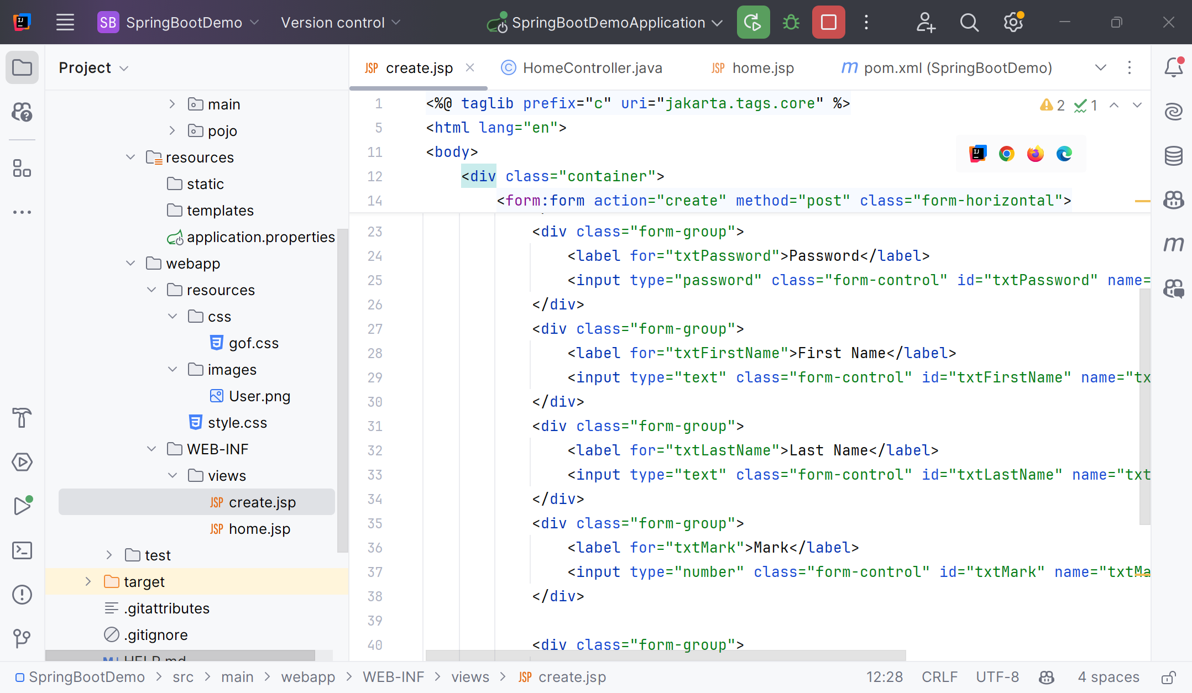
Create views : create.jsp

Slide 28
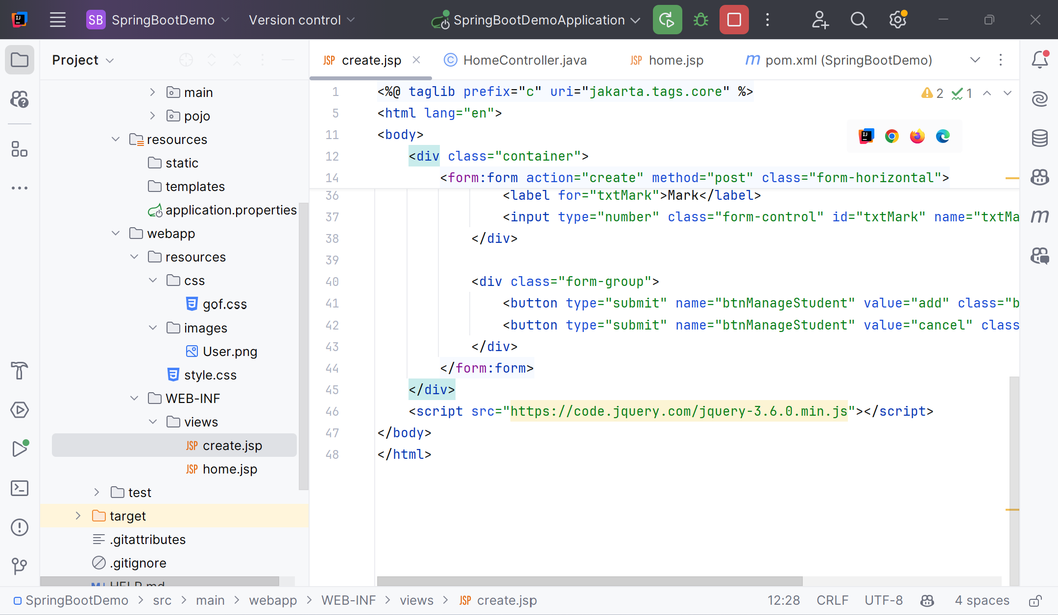
Create views : create.jsp

Slide 29
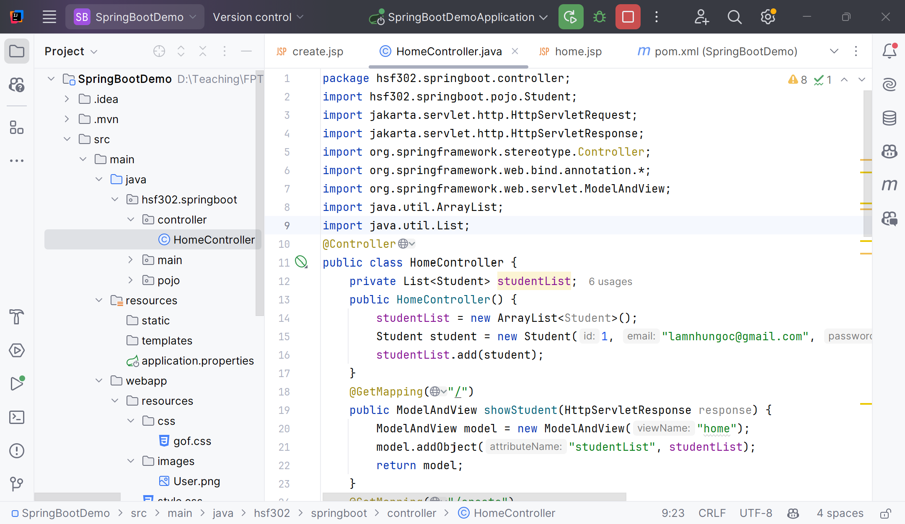
Create the HomeController.java

Slide 30
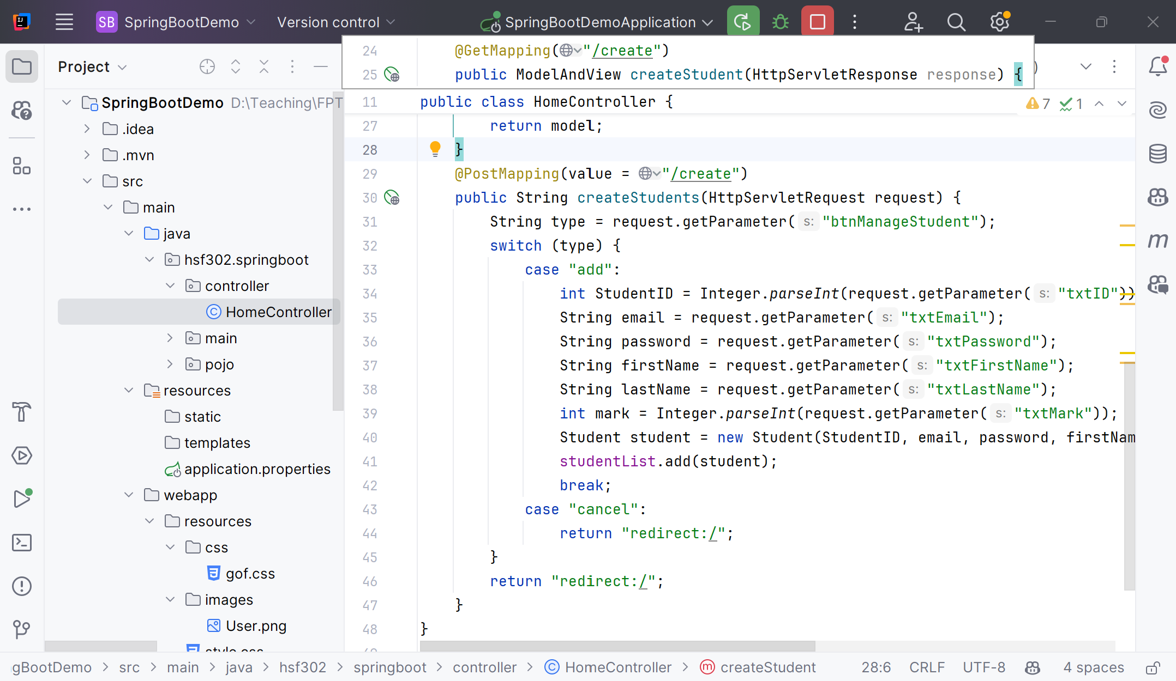
Create the HomeController.java

Slide 31
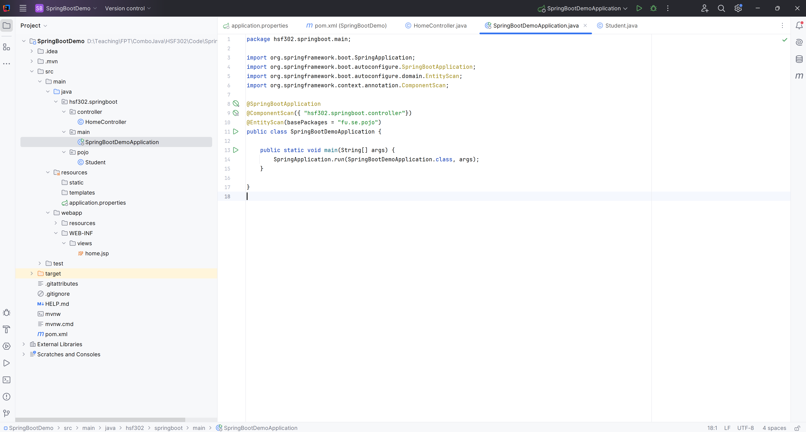
Edit SpringBoot Main

Slide 32
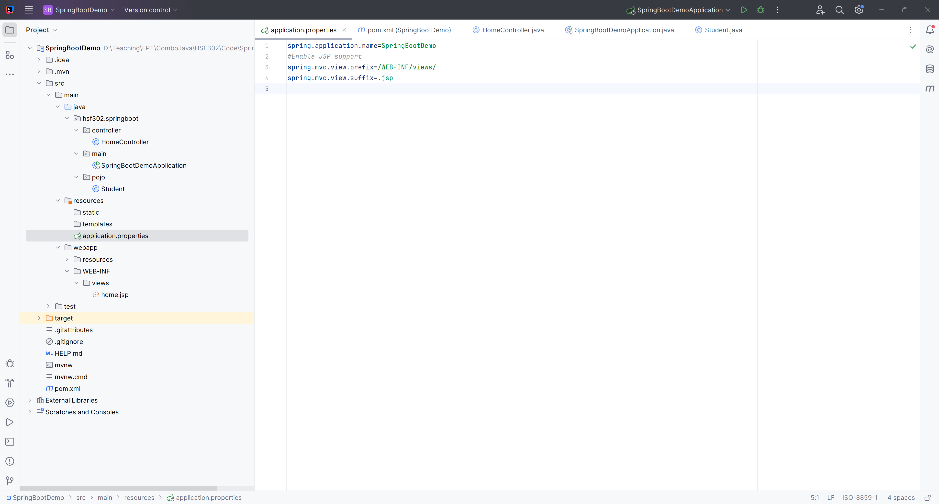
Edit the application.properties

Slide 33
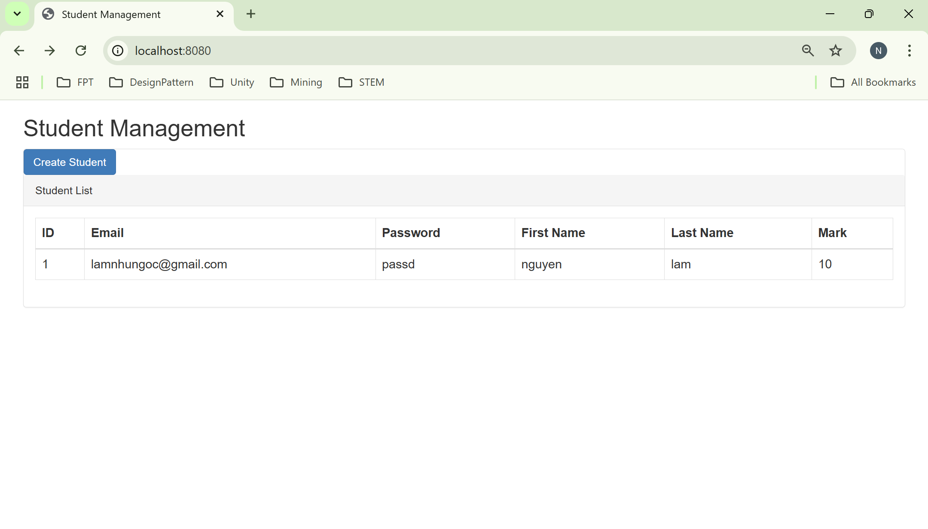
Run Program

Slide 34
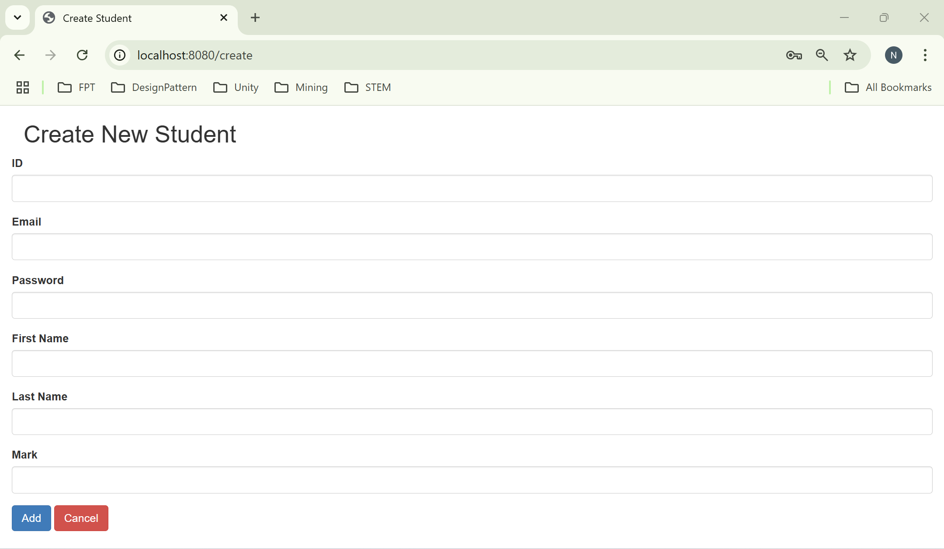
Result

Slide 35
Summary
Concepts were introduced:
Spring Boot
Advantages of using Spring Boot
Key features of Spring Boot
Demo Spring Boot with Collections

